Slide 1

Modern Web Testing with Playwright
Fast, reliable, and capable automation framework for the complex architecture of modern web applications.

Slide 2
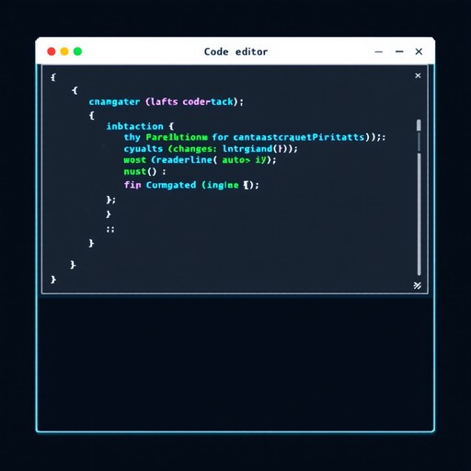

What is Playwright?
An open-source test automation framework backed by Microsoft, engineered for the modern web.
Extensive cross-language support natively including JavaScript, TypeScript, Python, Java, and .NET.
Provides flawless cross-browser testing across Chromium, Firefox, and WebKit rendering engines.
Operates out-of-process via WebSocket protocols, entirely avoiding the limitations of traditional Selenium drivers.

Slide 3






Core Advantages
Auto-Waiting
Browser Contexts
Parallel Execution
Playwright automatically waits for elements to be fully actionable before performing interactions, fundamentally eliminating flaky tests and arbitrary timeouts.
Create isolated, incognito-like sessions in milliseconds. Run multiple independent testing scenarios simultaneously without the massive overhead of new browser instances.
Drastically reduce your CI/CD pipeline completion times. Playwright runs your extensive test suites concurrently out-of-the-box leveraging all available CPU cores.

Slide 4

Competitive Comparison
Feature | Playwright | Cypress | Selenium
Execution Speed | Extremely Fast | Moderate | Slower (Driver Overhead)
Language Support | JS/TS, Python, Java, C# | JavaScript / TypeScript | Multiple Languages
Multi-Tab & iFrames | Seamless Native Support | Limited / Complex Setup | Supported natively
Network Interception | Native & Powerful | Supported | Requires External Proxies

Slide 5

Advanced Debugging
Trace Viewer & Inspector
Troubleshoot testing failures efficiently. Capture full DOM snapshots, intercept network requests, parse console logs, and record video executions to reliably reconstruct test failures exactly as they occurred.

Slide 6
Ready to Scale?
Transform your automated continuous testing strategy with Playwright.
Questions & Discussion

